Slide 1
eRouting Setup Guide
MSgt William Bechard

Slide 2
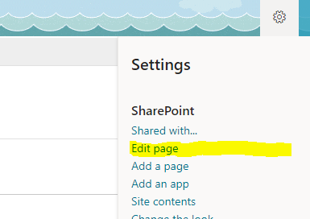
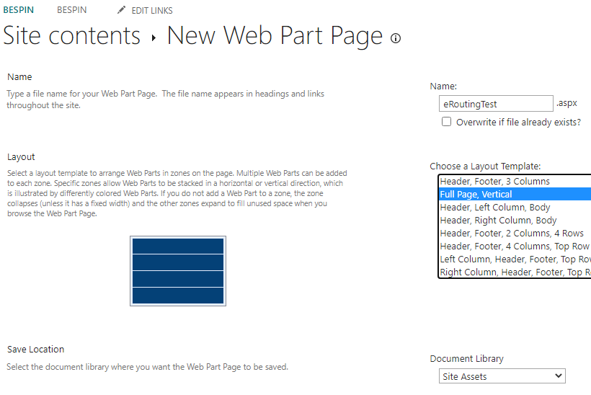
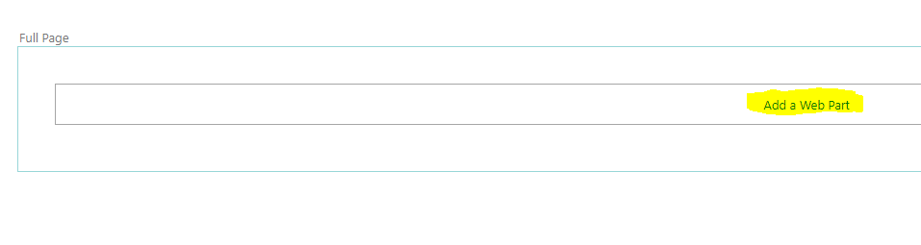
1. Create a (classic) WebPart Page
2. Click the Gear icon, then select Edit Page.
3. Click the Add a Webpart button that appears on the page.

Slide 3
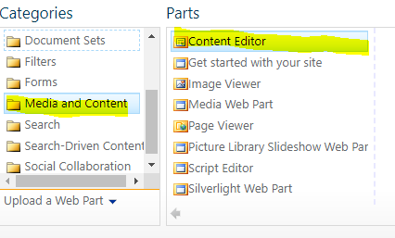
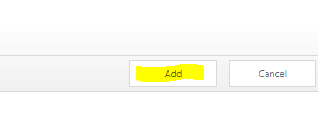
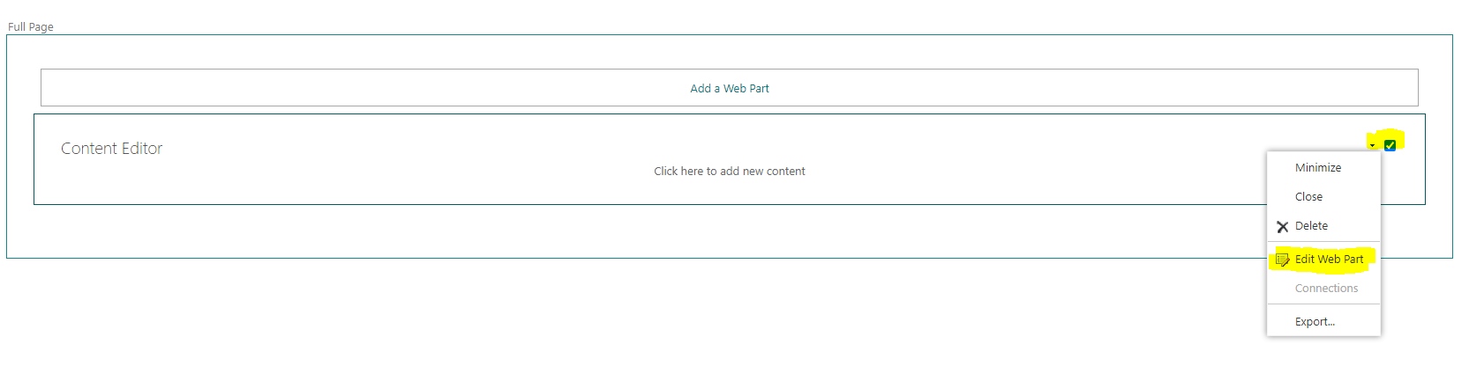
4. Select (Categories) Media and Content, and (Parts) Content Editor.
5. Then click Add
6. You now have a Content Editor WebPart. Lets Configure it. Hover the mouse over the top right of the WebPart click the checkbox, and select Edit Web Part

Slide 4
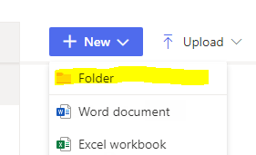
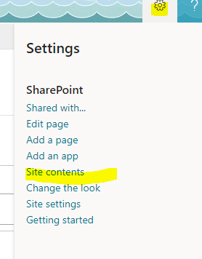
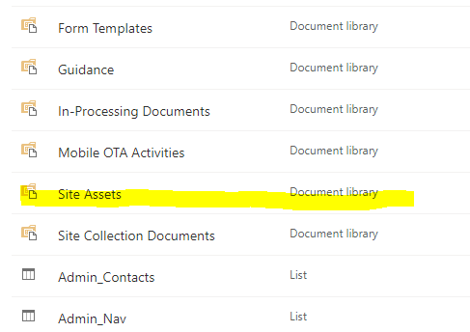
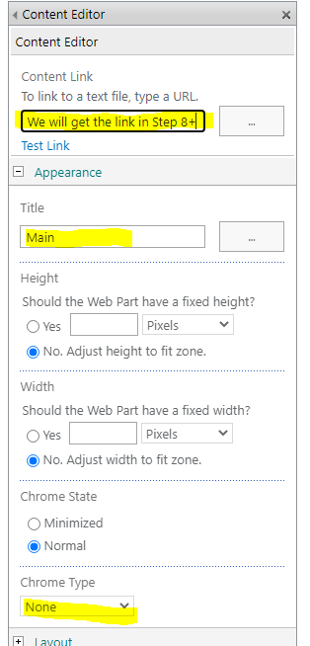
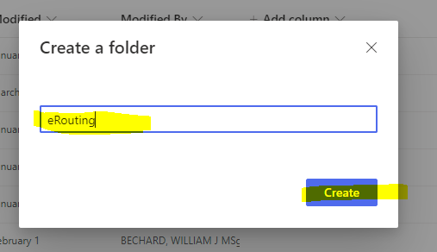
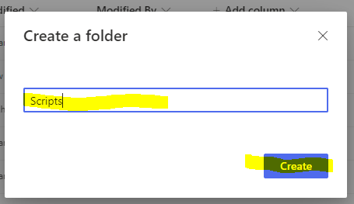
7. Expand Appearance, and name the WebPart something appropriate. Then select None from the Chome Type (this means the WebPart wont show, but its content/code will).
8. Copy the URL and paste in a different tab/window, then hit enter. Now select the Gear icon, then click on Site Contents
9. Click Site Assets
10. Click New, then Select Folder
11. Name doesn’t matter, but for organizational purposes I suggest when you create a new app you create a folder where are the code specific to that app will be stored. For me I named it eRouting, and will refer to it as such
12. I also suggest making another folder, though it could be in a more general/broad location like under the KM site, that will store scripts and libraries that ALL apps can use. This is a best practice. I named this folder just Scripts, and will refer to it as such

Slide 5
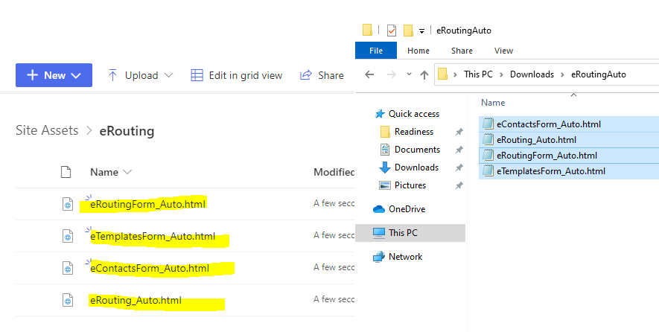
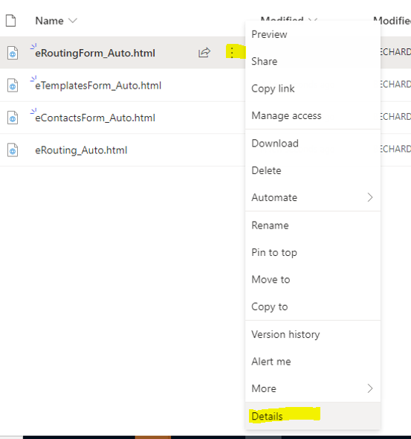
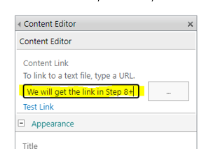
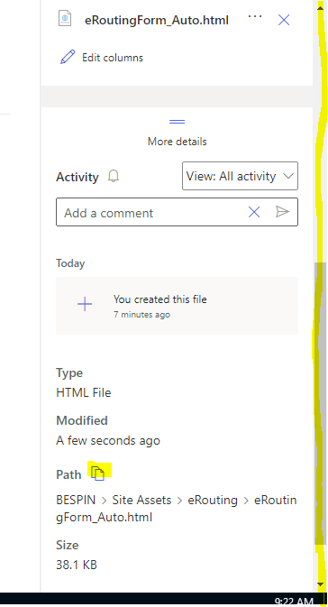
13. Now place the below files into the eRouting folder.
14. For each file, to get the path that you need, click on the 3 vert dots, then select Details.
15. Look at the info pane to the right of the window. You may need to scroll down until you see Path and its Icon. Click on the Icon and that will copy the path that you need
16. Paste the url link into the content Editor. For the primary site, you will want the url for eRouting_Auto. The others will be used later.

Slide 6
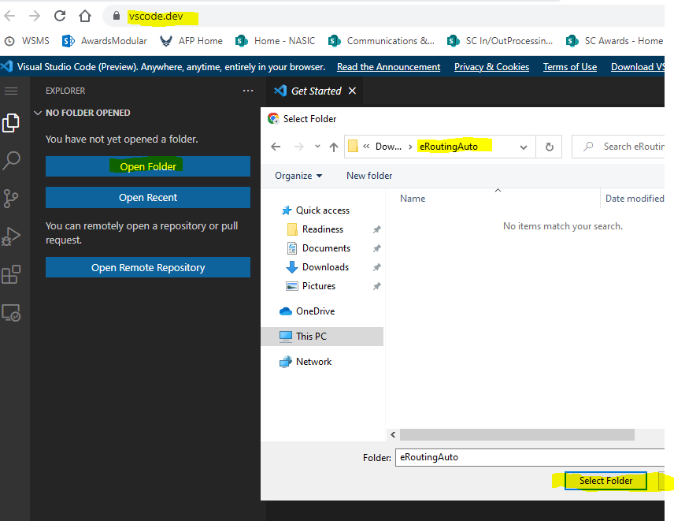
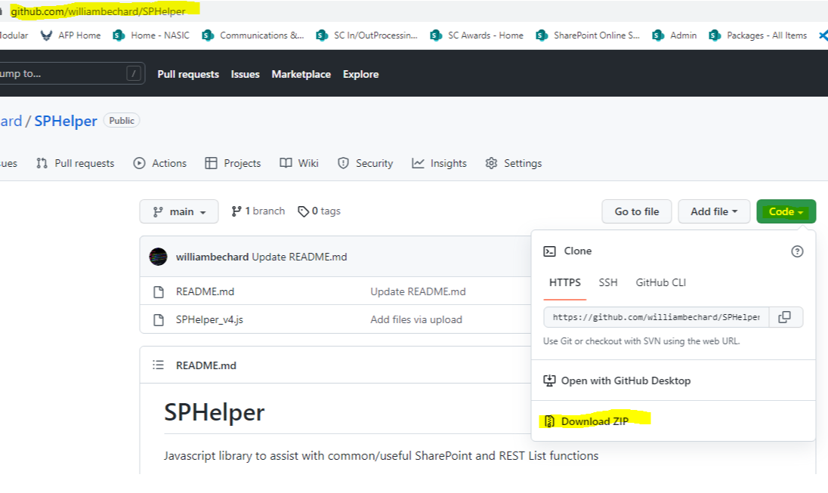
17. Use a code editor like vscode. You can probably use the browser version https://vscode.dev/, then select Open folder, and select the folder you saved the code to on your local hard drive.
18. Open the eRouting_Auto.html file, and you will need to change this script reference line. Adjust src=“” to wherever you store SPHelper_4.js. It does not matter where you store the file on SharePoint, but it is best practice for it to be in the Scripts folder, as it is a library that can be used by many apps
19. You can get the SPHelper.js file from the link github.com/williambechard/SPHelper. Select Code, then Download Zip. After downloading, extract it and move the SPHelper_vX.js file to Sharepoint. Grab its path then change the code referenced above.
Note: I suggest using a relative path in the src=“/…” rather than
src=https://.... While both will work, if SharePoint upgrades and the initial part of the link changes, if you used the full path you will have to go back and edit all links to reflect the change, however with a relative path you will probably not have to do that.

Slide 7
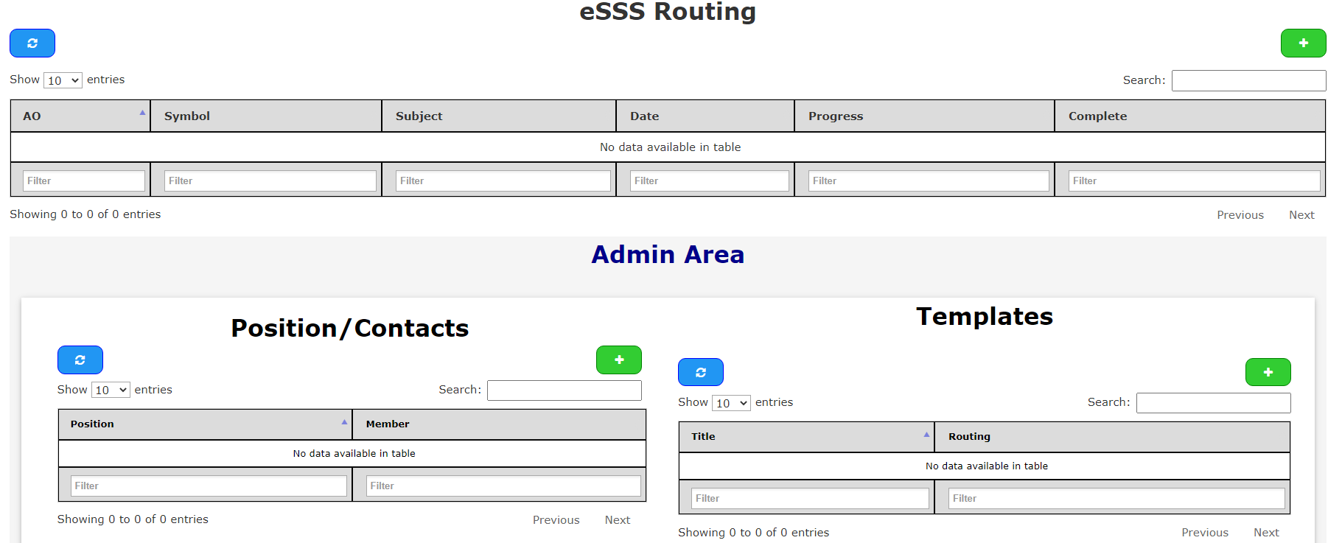
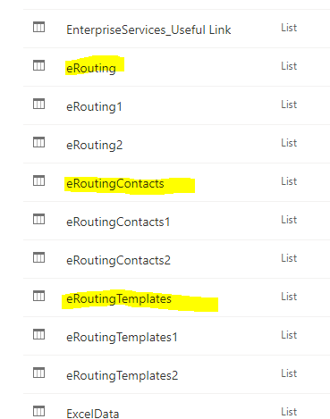
20. If successful, your page should look like this.
21. However we are not done yet, some small steps need to be accomplished as well. This is because we use the List’s NewForm/EditForm/DispForm.aspx and we must interject code into those forms (much like we did on this age, with a Content Editor Webpart)
22. Click on the Gear Icon,
then click Site Contents.
23. Find the 3 Lists that our program created. The process will be the same for each. Lets start with eRouting. Click on the eRouting List.

Slide 8
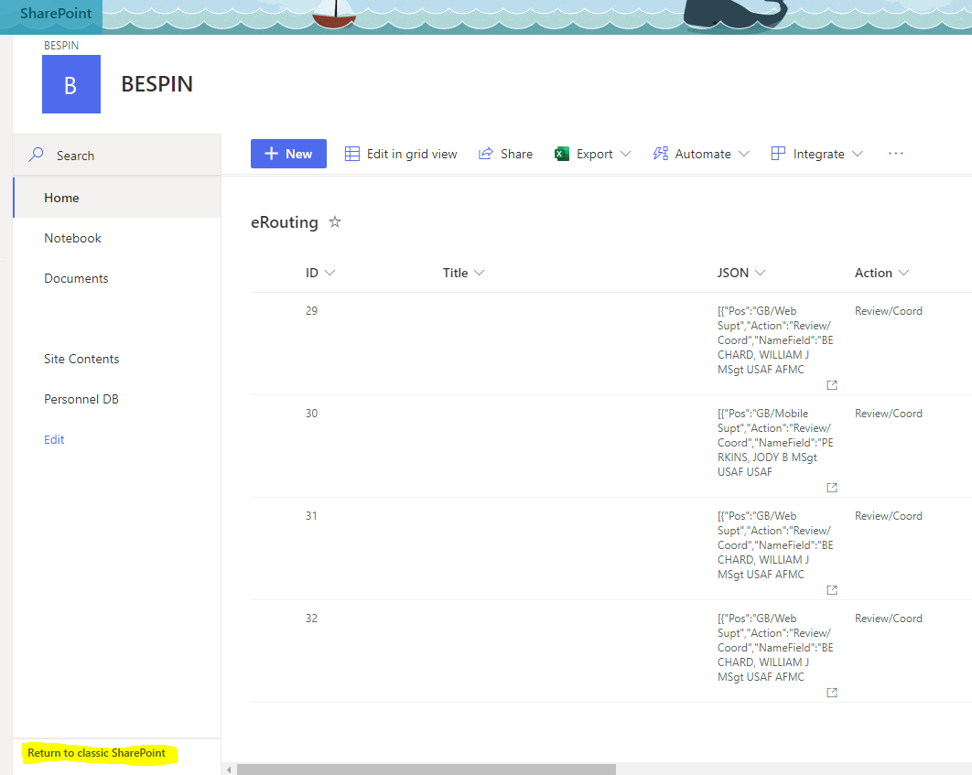
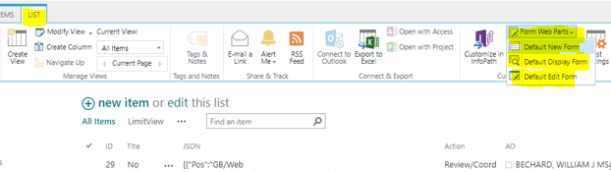
24. I am most familiar with classic mode, so I click (you have to do this 2x) Return to classic SharePoint
25. We will be click on each one. Start with Default New Form.
26. Follow the same steps as Sets 3 through 7, to Add a Content Editor WebPart, but this time set the Content Link url to the eRoutingForm_Auto.html file.
27. Do the exact same thing for the Default DispForm, and Default EditForm. Adding the same eRoutingForm_Auto.html to each page.
28. Do the same thing for the 2 other Lists.
eRoutingContacts, loading the eContactsForm_Auto.html to that List’s New Form, Edit Form, and Disp Form Default Forms, Content Editor WebPart.
eRoutingTemplates, loading the eTemplatesForm_Auto.html to that List’s New Form, Edit Form, and Disp Form Default Forms, Contet Editor WebPart.

Slide 9
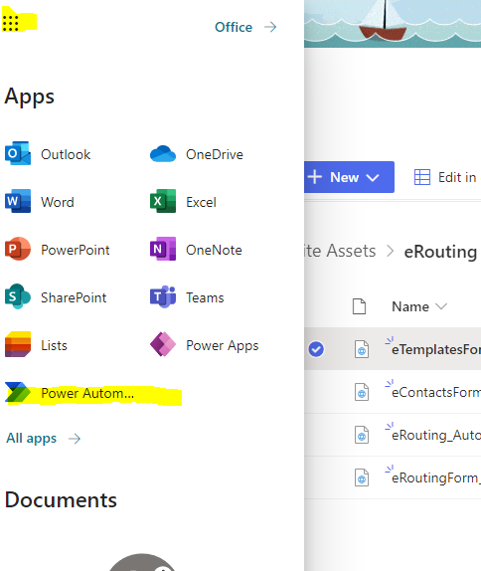
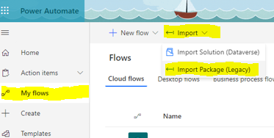
Setting Up Power Automoate
1. Click on the 9 square dot pattern at the top left of the window in SharePoint Online. Select Power Automate.
2. Select My flows, then The Import Tab/button at the top, and Import Package (Legacy)

Slide 10
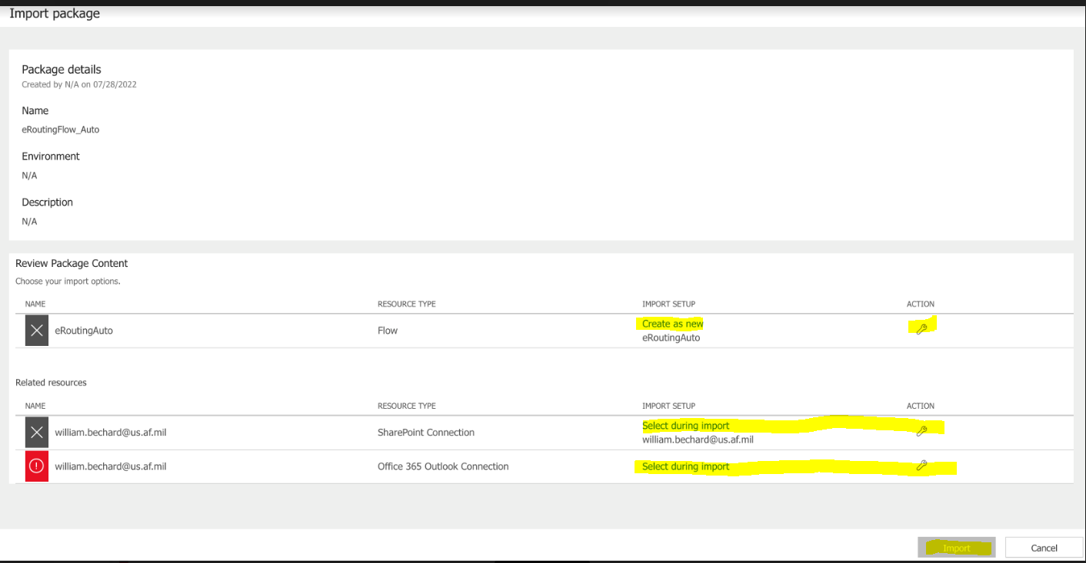
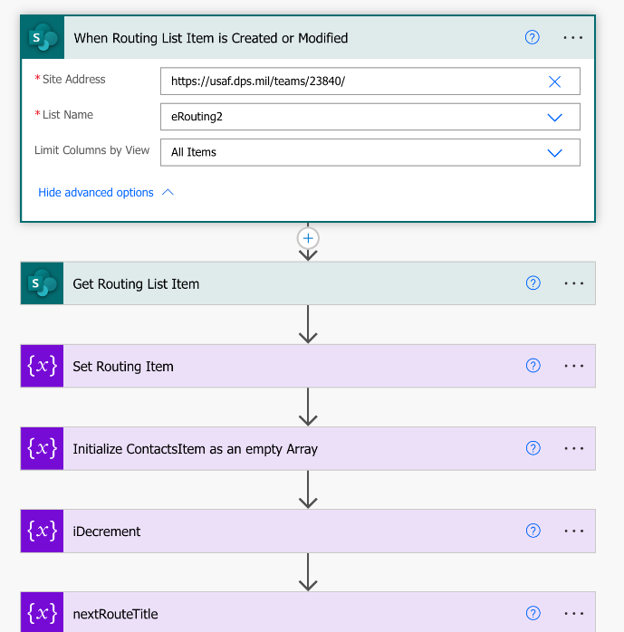
3. Select the Wrench and set the first row to Create as New, the other 2 should be selected as the admin/user. Then click Import. Once Import is done, click on the link that says Open Workflow
4. There are several changes that need to be made, as we need to ensure that the Workflow items point to the correct List/url(s)
5. Adjust Site Address URL to your site, then the List name to be eRouting (can select from dropdown), and click on the Show Advanced Options link and change the List Column by View to All Items

Slide 11
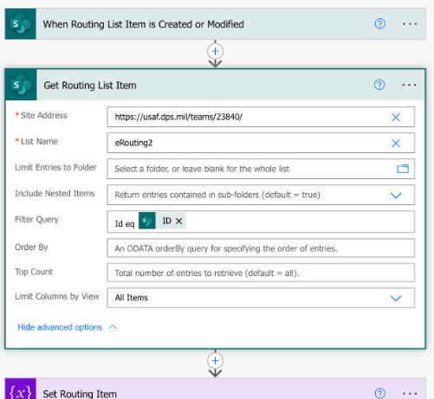
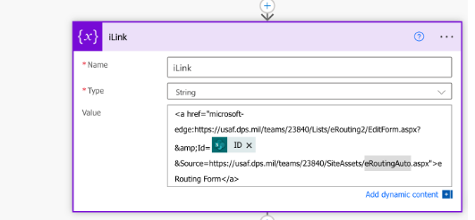

6. Next open and edit the Get Routing List Item below the previous one, and adjust the same properties (Site Address, List Name, and List Columns by View)
7. Several items down, edit the iLink item urls to match your site, and to match the name of the List
8. Expand If Comments has TEXT

Slide 12
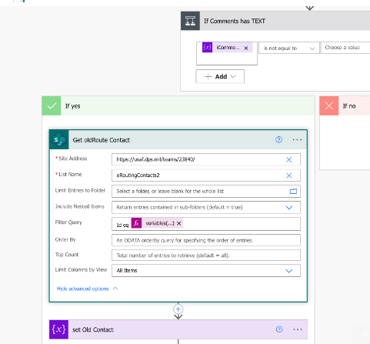
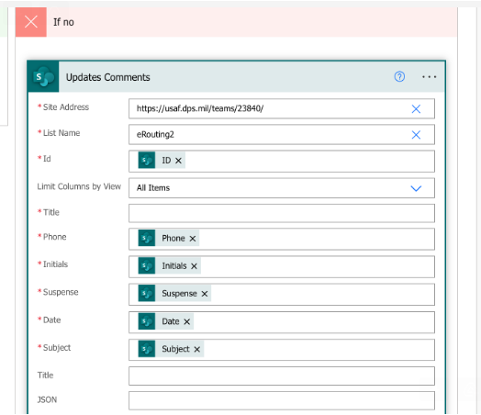
9. Expand Get oldRoute Contact, and update in the same way as the previous list (note that this should point to the eRoutingContacts List).
10. Continue down and expand the Do We Need to Update Or Save Now item, then Under no, Expand Updates Comments. Update this just like the previous list

Slide 13
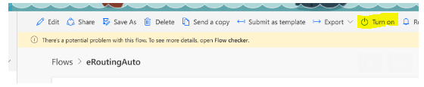
11. Expand If item was just Signed OR it’s the first time created (newForm), and Expand (under If yes) Check if any Sig block’s left.
Under If yes, expand Get Contacts and adjust as previously (targeting eRoutingContacts).
12. Expand the last Apply to Each (Update Item). Then Expand and update the Update Item box, just like previously (targeting eRouting List)
13. Scroll up a bit, and under If no expand Final Update. Make adjustments just like before (targeting eRouting List).
14. Save and if there are no errors use the back button (Upper left of window) to Go to the Flow Area and ensure Turn On has been clicked, so that the Flow remains active.

